Slide 1
CSSE3113 – Introduction To Software Engineering
UML Diagrams

Slide 2


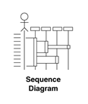
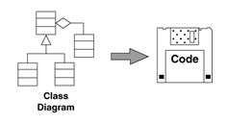
Beginnings of a Method
Systems Model

Slide 3
Interaction Models
All systems involve interaction of some kind…
This can be user interaction, which involves user inputs and outputs
Interaction between the system being developed and other systems
Or interaction between the components of the system
Use case modeling, which is mostly used to model interactions between a system and external actors (users or other systems).
Sequence diagrams, which are used to model interactions between system components, although external agents may also be included.

Slide 4
UML Sequence Diagrams
Describe the flow of messages, events, actions between objects
Show time sequences that are not easily depicted in other diagrams
Typically used to understand the logical flow of system
Emphasis on time ordering!

Slide 5
Sequence Diagram Key Parts
In a sequence diagram, objects and actors are aligned along the top of the diagram.
Labeled arrows indicate operations; the sequence of operations is from top to bottom.
The axes in a sequence diagram:
– horizontal: which object/participant is acting
– vertical: time

Slide 6
Developing Sequence Diagrams
Identify the relevant objects involved in the computation
Establish the role of each object
Identify the controller
Decide messages between objects

Slide 7
Sequence Diagram Notation
Object1 name:classname
Object 2name:classname
Actors
Objects

Slide 8
Sequence Diagram Notation
:Object 1
:Object 2
Lifelines
Identify the existence of the object over time.

Slide 9
Sequence Diagram Notation
:Object 1
:Object 2
Activations
Indicate when an object is performing an action

Slide 10
Sequence Diagram Notation
:Object 1
:Object 2
message
Messages
Indicate the communications between objects

Slide 11
Sequence Diagram Notation
:Object 1
:Object 2
message
message
Sequence
Vertical position signifies sequence – earlier messages appear nearer the top.

Slide 12
Case Study: Ride Booking System
Scenario
A user wants to book a ride using a mobile app. The system connects the user with nearby drivers, processes the request, and completes the ride.
Main Actors
Customer (User)
Mobile App
Driver
Payment System

Slide 13
Step-by-Step Interaction
Step 1: Request Ride Customer → App “Request Ride (Location, Destination)” | Step 4: Notify Customer App → Customer “Driver Assigned”
Step 2: Find Driver App → Driver “Ride Request” | Step 5: Start Ride Customer → Driver “Start Ride”
Step 3: Accept Ride Driver → App “Accept Ride” | Step 6: Complete Ride Driver → App “Ride Completed”
Step 7: Payment Processing App → Payment System “Process Payment” Payment System → App “Payment Successful”

Slide 14
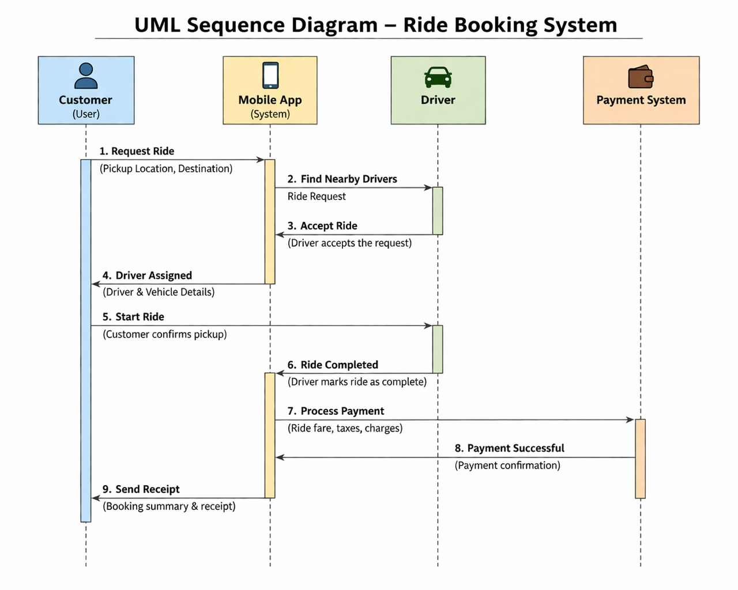

Slide 15
Exercise - MediConnect
MediConnect is a mobile social platform where patients with similar chronic conditions share experiences, access verified medical resources, and receive emotional support. After logging in, a user (patient) navigates the “Community Feed” to view posts from peers and healthcare moderators. To ask a question, the user selects “New Post,” enters symptoms or concerns, and attaches relevant tags (e.g., #Diabetes, #Fatigue). The app routes the post to a content moderator bot, which scans for medical misinformation or distressing language; if flagged, the post is held for human review. Once approved, the post appears in real-time on the feeds of users following that tag. Another user can reply by selecting “Comment,” triggering a notification to the original author. To escalate a serious symptom, the user taps “Ask a Clinician,” which sends an anonymized message to an on-call volunteer doctor via an integrated secure chat. The doctor’s response is saved to the user’s private “Health Journal” for future reference. Moderators also have a “Pin Verified Resource” action to highlight trustworthy articles or local support groups at the top of the feed. No purchase or payment occurs; all features rely on reputation-based trust scores and voluntary moderation.

Slide 16
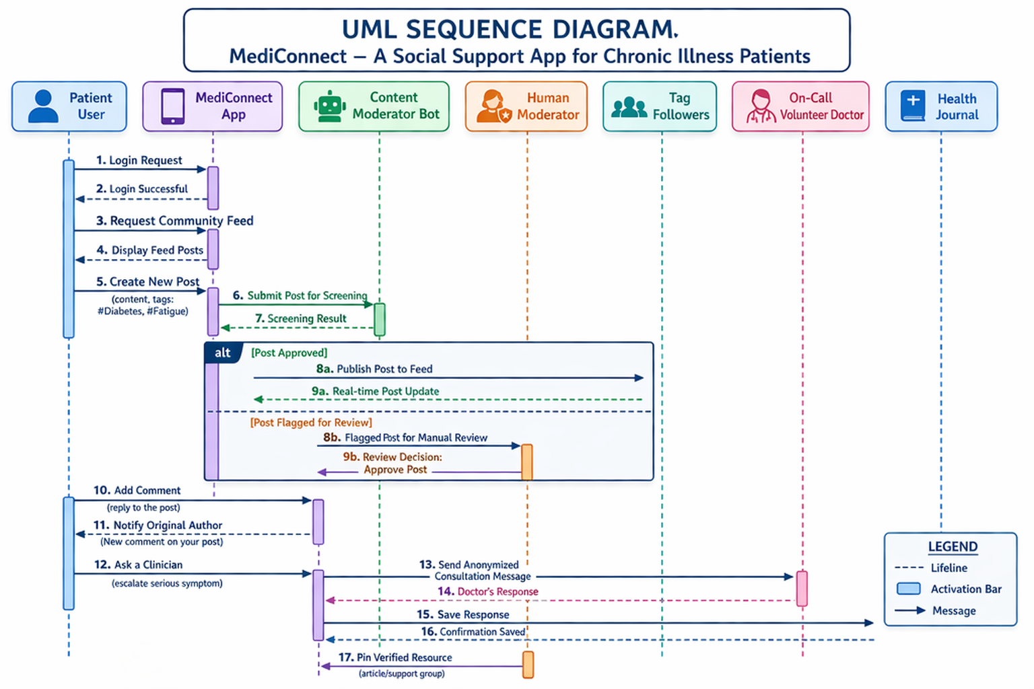

Slide 17
Entity/Relationship Modelling
ERD is a data modeling technique used in software engineering to produce a conceptual data model of an information system.
Illustrate the logical structure of database.
It describe how these data are related to each other.
For example, the entities writer, novel, and consumer may be described using ER diagrams this way:

Slide 18
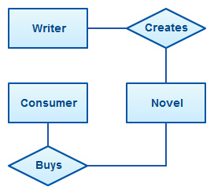
Entity/Relationship Modelling

Slide 19
Entity/Relationship Modelling
E/R Modelling is used for conceptual design
Entities - objects or items of interest
Attributes - Properties of an entity
Relationships - links between entities
Example
In a University database we might have entities for Students, Modules and Lecturers. Students might have attributes such as their ID, Name, and Course, and could have relationships with Modules (enrolment) and Lecturers.

Slide 20
Entity/Relationship Diagrams
E/R Models are often represented as E/R diagrams
Lecturer
ID
Name
Ph#
teaches
Student
Course
Register

Slide 21
Entities
Entities represent objects or things of interest
Physical things like students, lecturers, employees..
More abstract things like modules, orders, courses, projects
Entities have
A general type or class, such as Lecturer or Module
Instances of that particular type, such as Steve Mills, Natasha are instances of Lecturer
Attributes (such as name, email address)

Slide 22
Entities
In an E/R Diagram, an entity is usually drawn as a box with rounded corners or Rectangle
The box is labelled with the name of that entity
Lecturer
ID
Name
PH#
teaches
Student
course
Register

Slide 23
Attributes
Attributes are properties, or details about an entity
Students have IDs, names, courses, addresses, …
Courses have codes, titles, credit weights. .…

Slide 24
Diagramming Attributes
In an E/R Diagram attributes may be drawn as ovals
Each attribute is linked to its entity by a line
The name of the attribute is written in the oval
Lecturer
ID
Name
Ph#
Teaches
Student
Course
Register

Slide 25
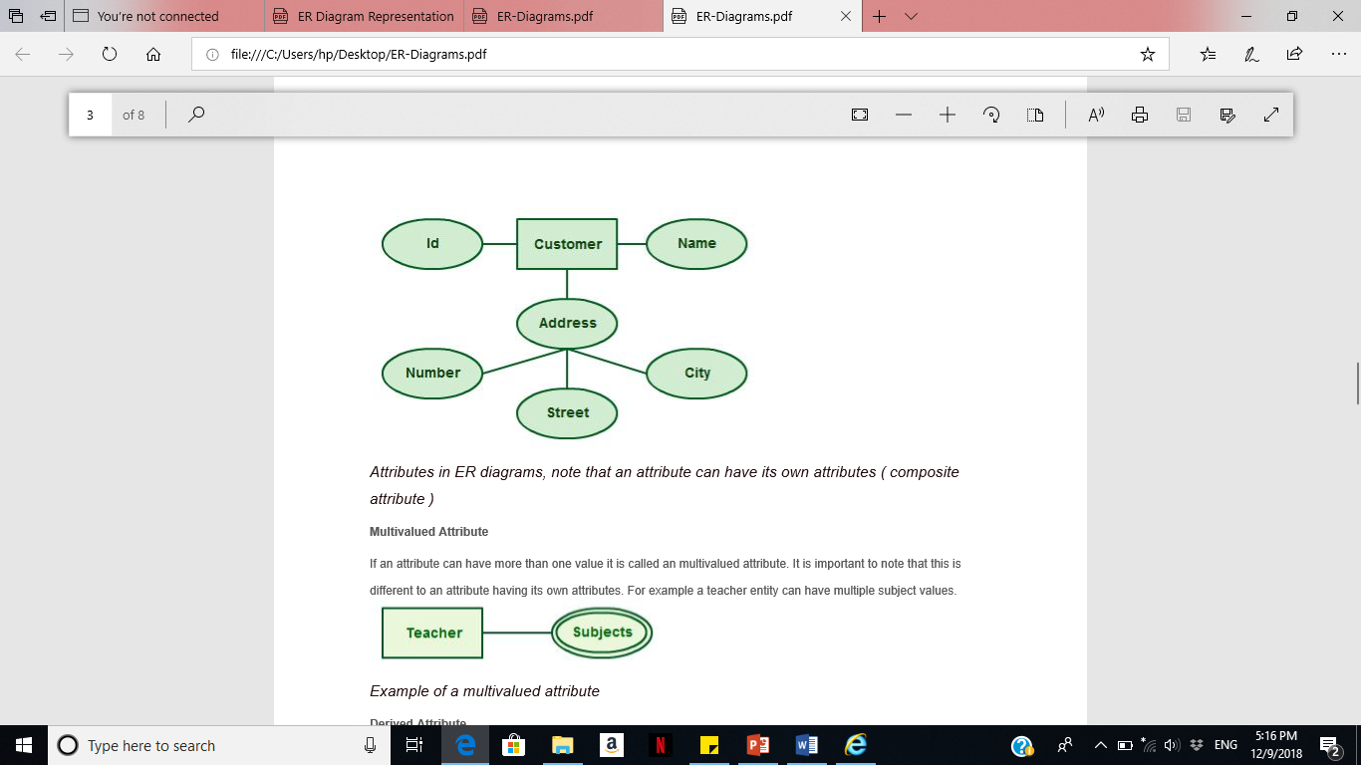
Types of Attributes
Composite attributes
Attributes can also have their own specific attributes. For example, the attribute “customer address” can have the attributes “number, street, city, and state”.

Slide 26
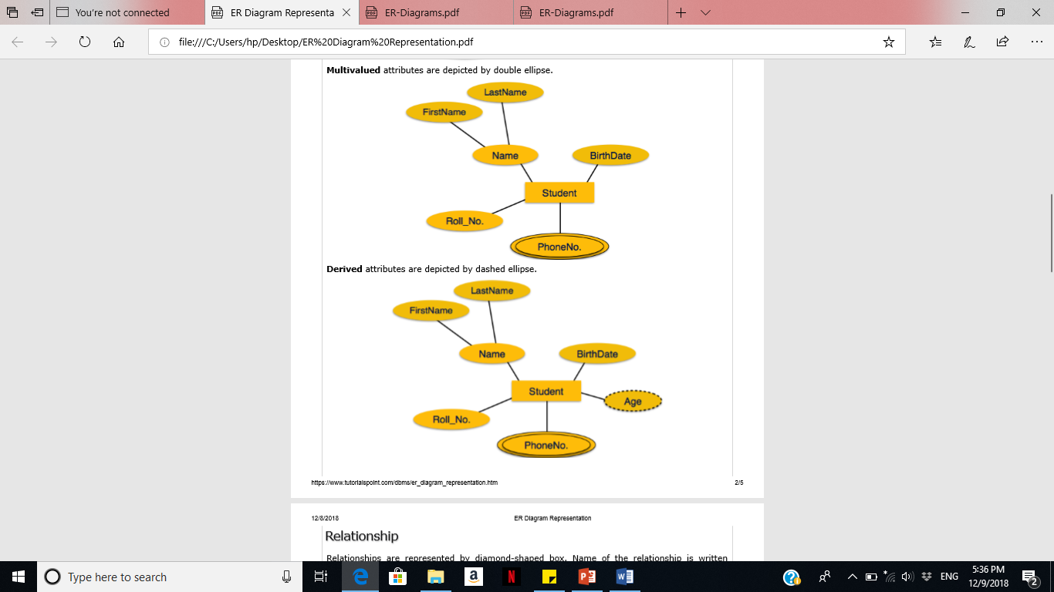
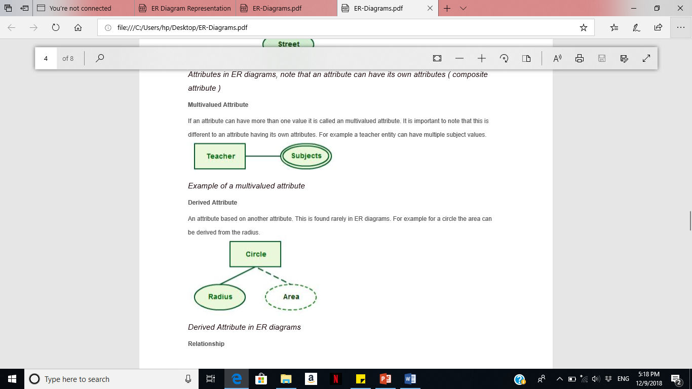
Types of Attributes
Multivalued Attribute
If an attribute can have more than one value it is called an multivalued attribute.
For example a teacher entity can have multiple subject values.

Slide 27
Types of Attributes
Derived Attribute
An attribute based on another attribute. This is found rarely in ER diagrams. For example for a circle the area can be derived from the radius.

Slide 28
Relationships
Relationships are an association between two or more entities
Each Student takes several Courses
Each Course is taught by a Lecturer
Each Employee works for a single Department
Relationships have
A name
A set of entities that participate in them
A degree - the number of entities that participate (most have degree 2)
A cardinality ratio

Slide 29
Cardinality Ratios
Each entity in a relationship can participate in zero, one, or more than one instances of that relationship
This leads to 3 types of relationship…
One to one (1:1)
Each lecturer has a unique office
One to many (1:M)
A lecturer may teaches many students, but each student has just one tutor for specific course
Many to many (M:M)
Each student takes several courses and each course is taken by several students

Slide 30
Diagramming Relationships
Relationships are links between two entities
The name is given in a diamond box
The ends of the link show cardinality
Lecturer
ID
Name
Ph#
Teaches
Student
Course
Register
One
Many

Slide 31
Making E/R Models
To make an E/R model you need to identify
Entities
Attributes
Relationships
Cardinality ratios
from a description
General guidelines
Since entities are things or objects they are often nouns in the description
Attributes are properties, and often nouns
Verbs often describe relationships between entities

Slide 32
Example
RideShare Connect is a ride-sharing and carpooling platform designed to connect drivers with available seats to passengers traveling in the same direction, with the goal of reducing traffic congestion and lowering carbon emissions. The system must manage comprehensive user profiles for both drivers and passengers, maintain detailed ride listings including departure times, routes, and available seat capacity, and facilitate a seamless booking process where passengers can search for and reserve rides that match their travel needs. Additionally, the platform must track payment transactions for completed rides, handle the financial settlement between passengers and drivers, and enable users to leave and view reviews and ratings to ensure accountability and quality of service. Behind the scenes, the database must support complex relational operations such as matching passengers to suitable rides based on location, time, and seat availability, maintaining accurate booking statuses, and ensuring proper transaction records that link payments to specific completed rides, thereby creating a reliable, scalable, and user-friendly ecosystem for sustainable urban mobility.

Slide 33
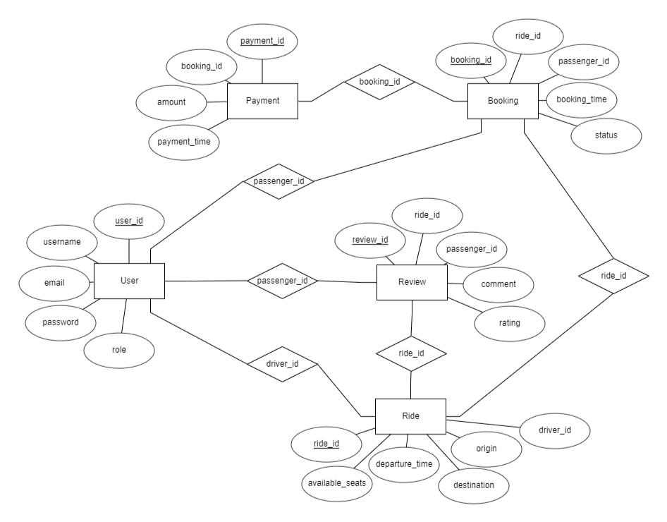

Slide 34
Data Flow Diagram (DFD)
The distinguishing features of DFDs are as follows:
Data flow diagrams capture the flow of data in a system.
It describes data origination, transformations and consumption in a system.

Slide 35
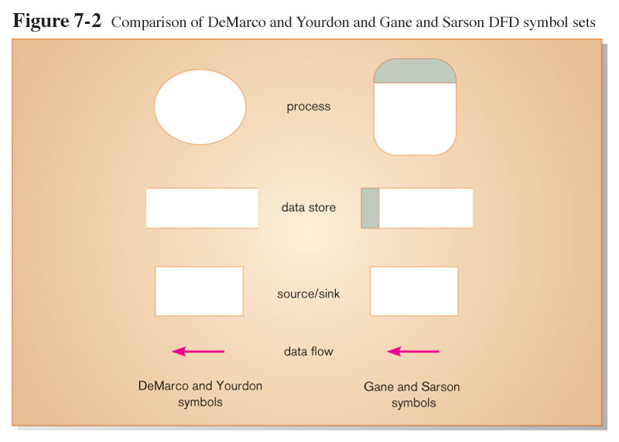
The DFD Notation

Slide 36
DFD Components
DFDs consist of four basic components that illustrate how data flows in a system: entity, process, data store, and data flow.
Process: work or actions performed on data (inside the system).
Data Store: Data at rest (inside the system).
Source/ Sink (Entity): External entity that is origin or destination of data (outside the system).
Data flow: arrows depicting movement of data.

Slide 37
DFD Components
Entity:
An entity is the source or destination of data. The source in a DFD represents these entities that are outside the context of the system. Entities either provide data to the system (referred to as a source) or receive data from it (referred to as a sink).
Process:
The process is the manipulation or work that transforms data. In other words, a process receives input and generates some output. Process names (simple verbs and dataflow names, such as “Submit Payment” or “Get Invoice”).

Slide 38
DFD Components
Data Store:
A data store is where a process stores data between processes for later retrieval by that same process or another one. Files and tables are considered data stores. Data store names (plural) are simple but meaningful, such as “customers,” “orders,” and “products.”
Data Flow:
Data flow is the movement of data between the entity, the process, and the data store. Data flow portrays the interface between the components of the DFD. The flow of data in a DFD is named to reflect the nature of the data used (these names should also be unique within a specific DFD).

Slide 39
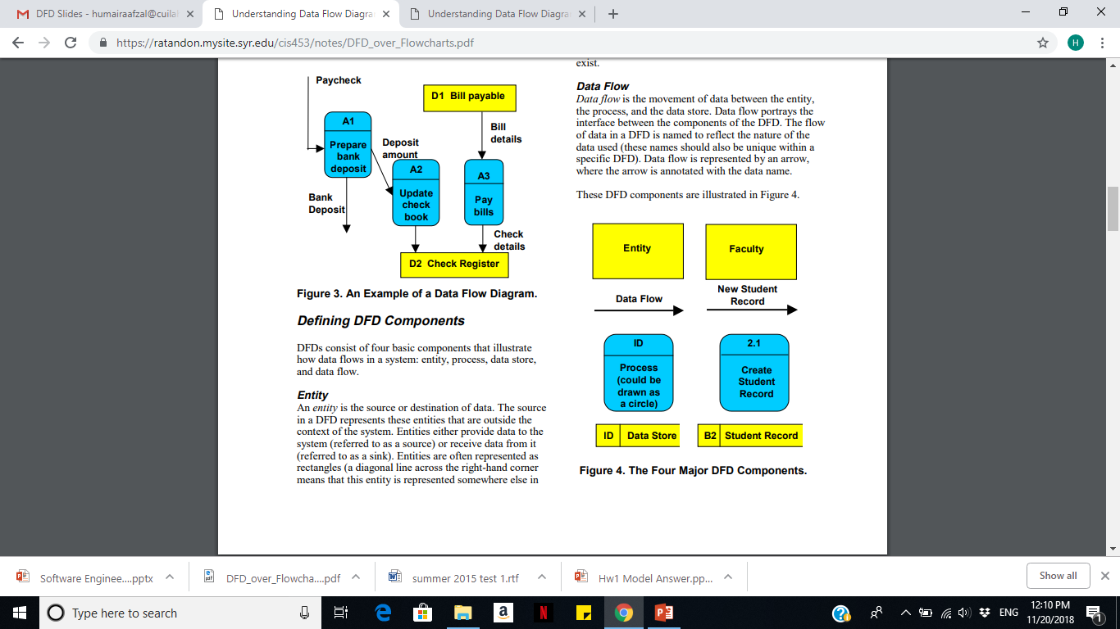
DFD Components

Slide 40
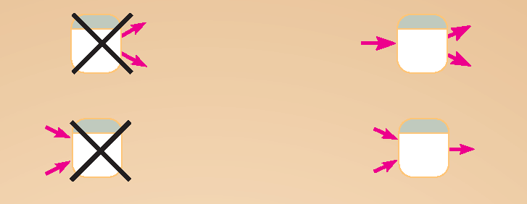
DFD Diagramming Rules (Process)
No process can have only outputs or only inputs. Processes must have both outputs and inputs.
Process labels should be verb phrases.

Slide 41
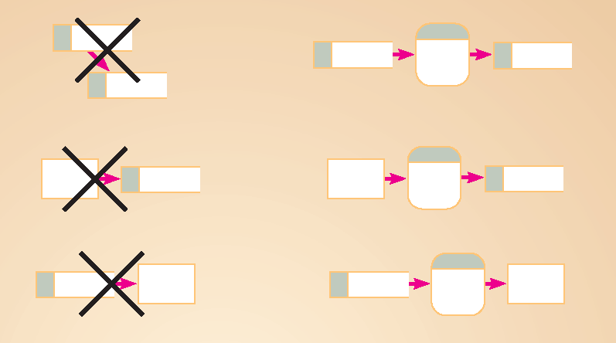
DFD Diagramming Rules (Data Stores)
All flows to or from a data store must move through a process.
Data Store labels should be noun phrases.

Slide 42
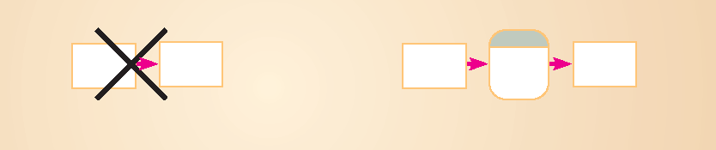
DFD Diagramming Rules (Source/Sink)
No data moves directly between external entities without going through a process.
Source and Sink labels should be noun phrases.

Slide 43
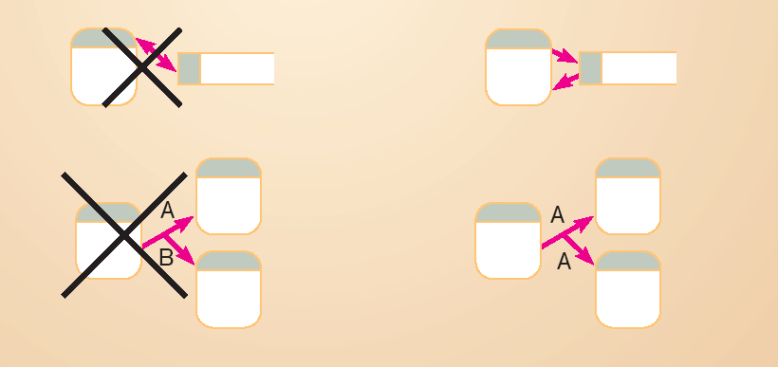
DFD Diagramming Rules (Dataflow)
Bidirectional flow between process and data store is represented by two separate arrows.

Slide 44
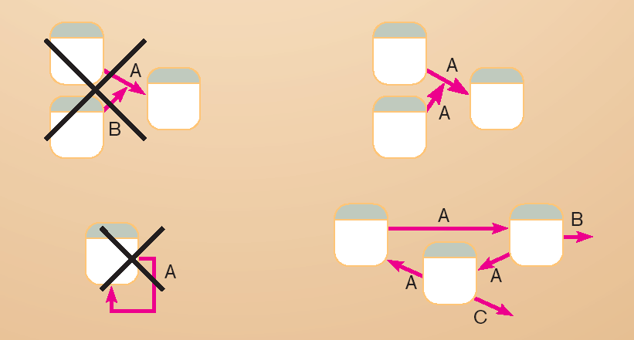
DFD Diagramming Rules (Dataflow)
Data flow cannot go directly from a process to itself, must go through intervening processes.

Slide 45
DFD Diagramming Rules (Dataflow)
Data flow from a process to a data store means update (insert, delete or change).
Data flow from a data store to a process means retrieve or use.

Slide 46
DFD Levels
Context DFD / Level-0 DFD
Level-1 DFD
Level-n DFD

Slide 47
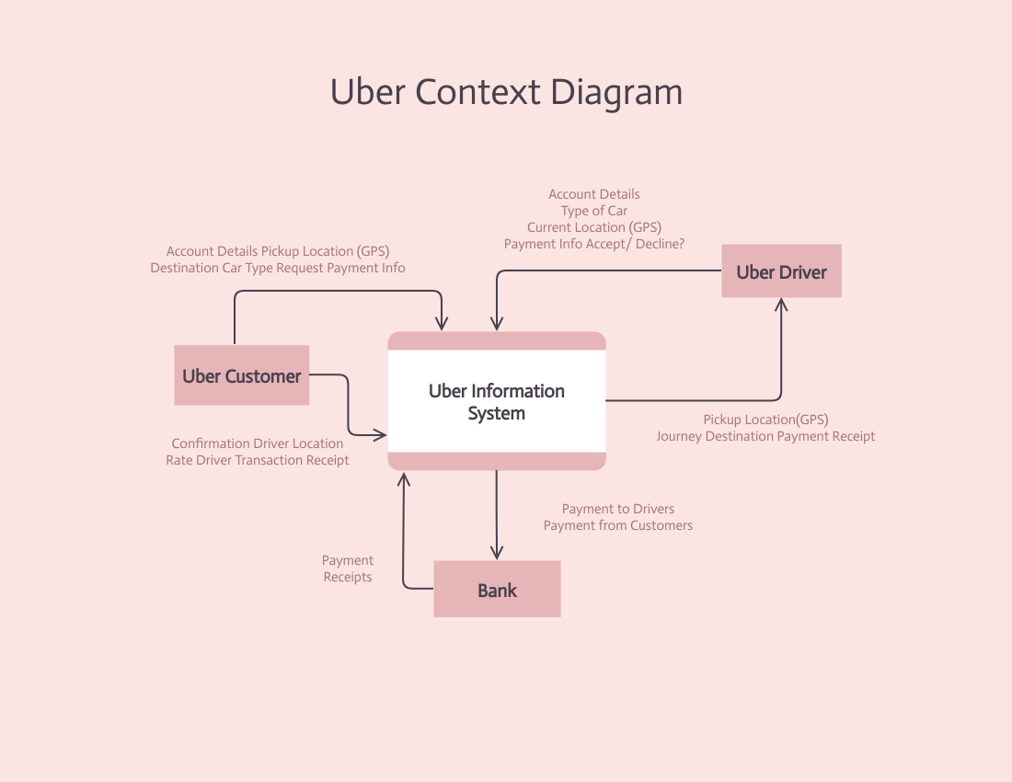
Context Diagram of Ride Booking App

Slide 48
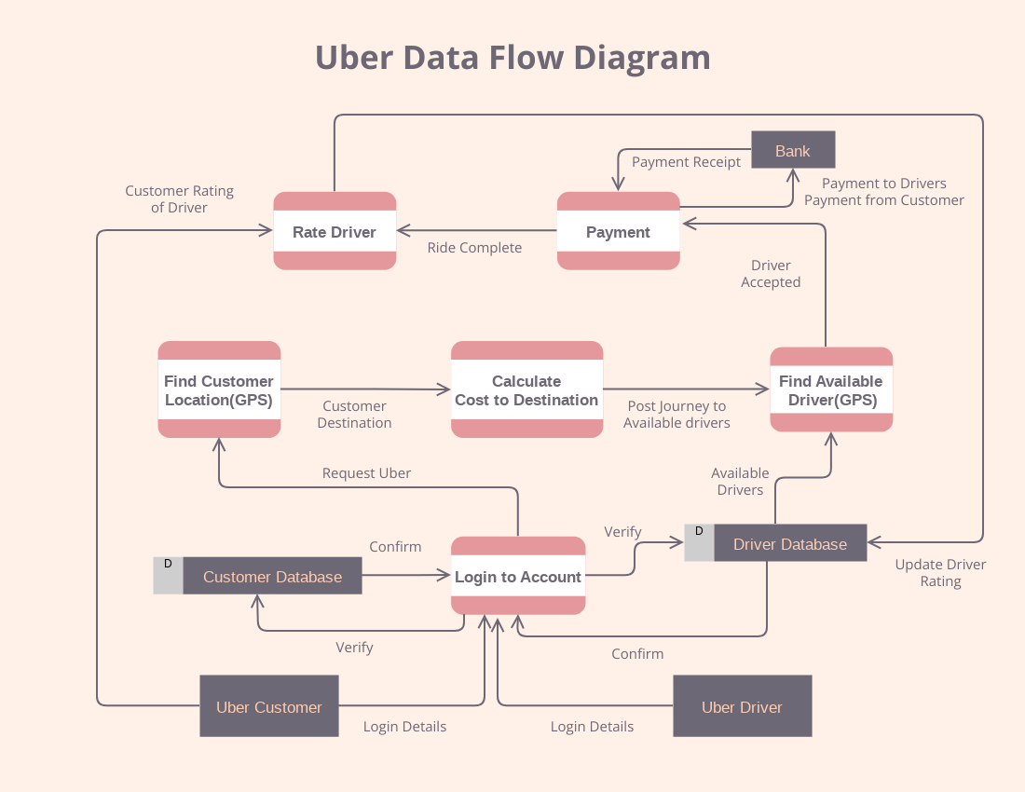
Level-1 DFD

Slide 49
Case Study
Draw a context level data flow diagram for a patient monitoring system.
Process of patient monitoring system:
A patient’s vital signs are transmitted to this system, which may invoke a warning message to the nurse if these signs fall into the critical range. Nurse may request for a report, which the patient monitoring system retrieves from the patient log, and returns it to the nurse again.

Slide 50
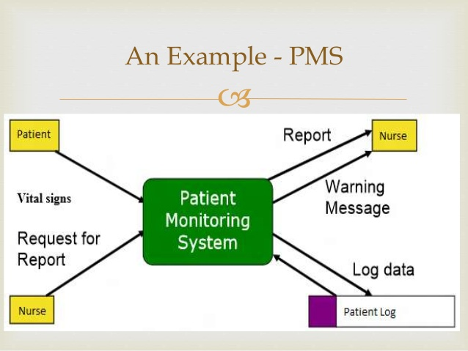

Slide 51
Consider the following case study and answer the questions written at the end of text.
“ Pizza Express wants to install a new software system to record orders for take-away pizza. When customers call Pizza Express on the phone, they are asked about their data and order details. Once the order is taken the total cost (including delivery and any applicable discount) is calculated. A receipt is printed. The order is then given to the chef to make the pizza. Occasionally, special offers (coupons) are printed so that the customer can get a discount. Order details are kept for comparison with last year’s performance.”
Develop the Context Level DFD and DFD Level 1 Diagram for the above scenario.

Slide 52
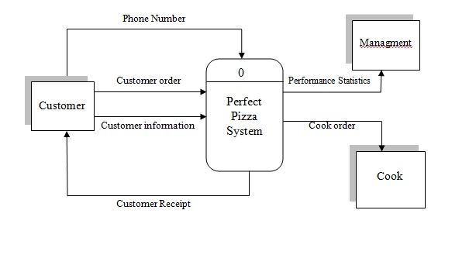
Context Diagram

Slide 53
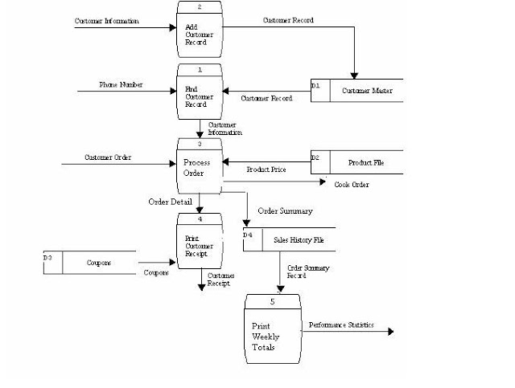
Level 1 DFD

Slide 54
Case Study
Consider a mail order company that distributes CDs and tapes at discount prices to its members.
When an order processing clerk receives an order form, she verifies that the sender is a member by checking the MEMBER FILE.
If the sender is not a member, the clerk returns the order along with a membership application form.
If the customer is a member, the clerk verifies the order item data by checking the ITEM FILE.
Then the clerk enters the order data and saves it to the DAIILY ORDERS FILE.
At the same time the clerk also prints an invoice and shipping list for each order, which are forwarded to the ORDER FULFILLMENT DEPARTMENT for processing there.
Develop the Context Level DFD and DFD Level 1 Diagram for the above scenario.

